Slide 1
Getting It System Toolkit:
GIST for Web – discovery & delivery changed
Tim Bowersox, Cyril Oberlander, Kate Pitcher, Mark Sullivan
State University of New York, Geneseo College
IDS Project Conference
August 3rd and 4th, 2010
Notes:
Cyril

Slide 2
What is GIST?
Getting systems to do more work for you and your users…
More practically speaking, it is a system for:
enhancing user’s request experience & delivery service;
enabling user-initiated purchasing requests for acquisitions and interlibrary loan;
enhancing coordinated collection development;
merging Acquisitions and ILL request workflow using ILLiad.
Notes:
So what is GIST?
GIST is a customizable set of tools and workflows for ILLiad 8 that enhances:
interlibrary loan and just-in-time acquisitions services;
purchase request processing;
and coordinated collection development efforts.
GIST enables acquisitions staff to benefit from ILLiad’s request management system, and GIST makes ILLiad an even more powerful tool for ILL.

Slide 3
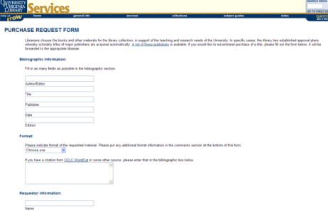
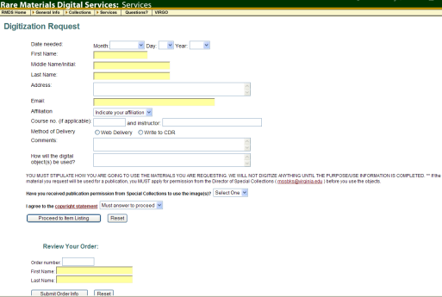
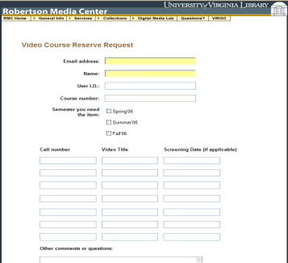
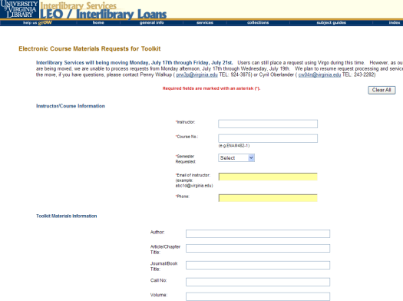
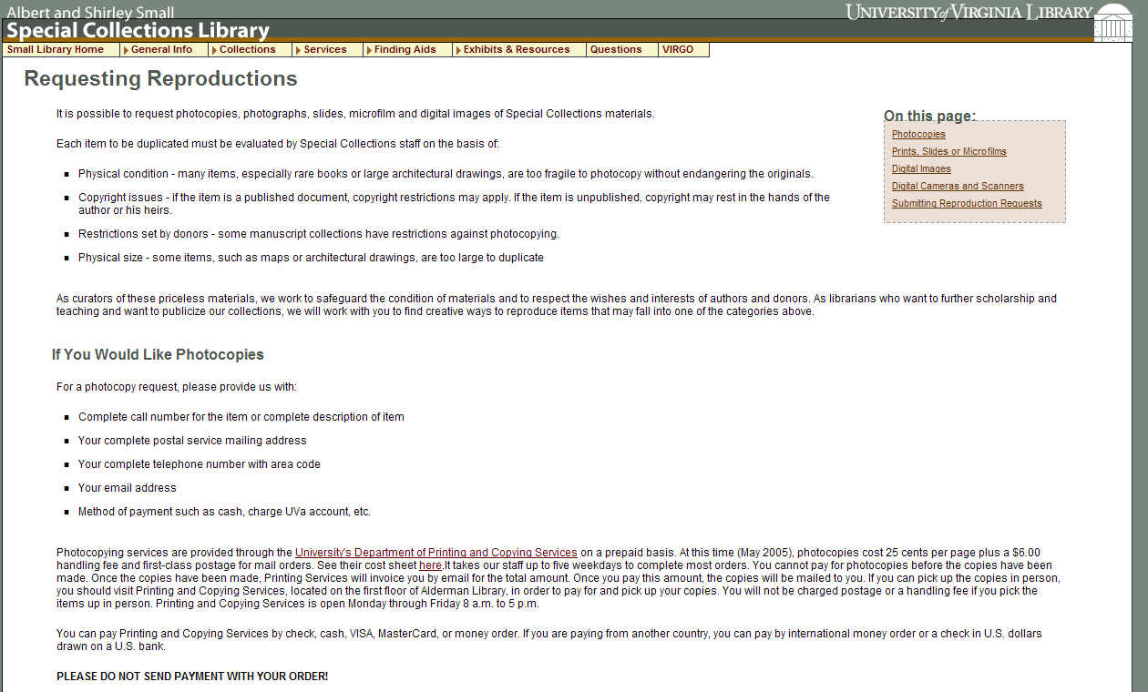
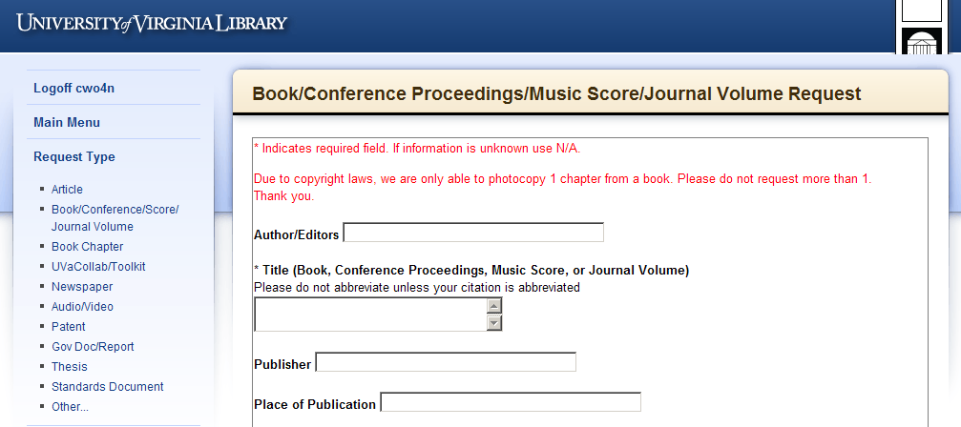
Service Request – what context?
Rare Materials Scan Request
Purchase Request
Video Booking Request
Library Services are fragmented by
Request Systems that
reinforce functional divisions
E-Reserve Request
Special Collection Duplication Request
Interlibrary Services Request
Notes:
Add that the reality of our numerous disparate request systems, which serve as vehicles for end user services, sends the message that our creativity, well intentioned, has run amok with functional divisions.
How does the very fractured service design or request environment we offer make any sense to our users?
If anything, it is reinforcement of the internal reality…

Slide 4
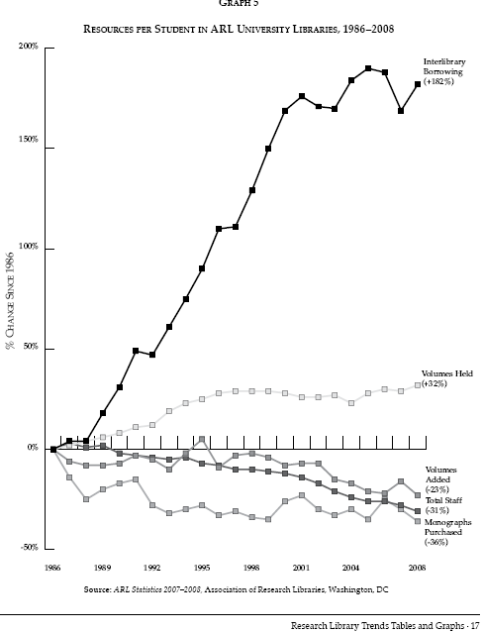
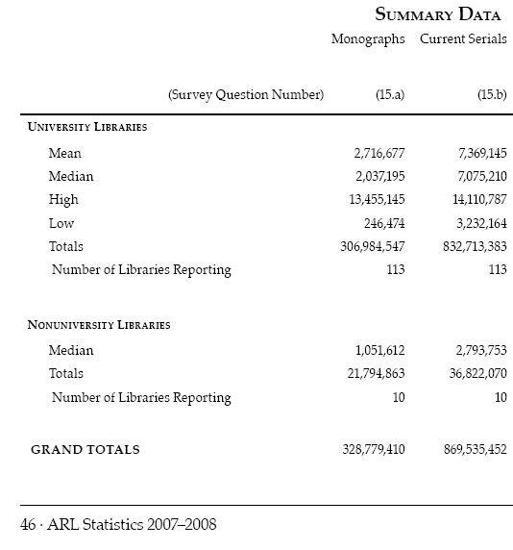
Monograph Spending & ILL
2009 over 11 Million ILL requests (ALA)
Association of Research Libraries 2007-2008
Notes:
http://www.arl.org/bm~doc/arlstat08.pdf p. 46, 17

Slide 5
It’s the Economy…
April 6, 2008 a day in the life of ILL…
110 borrowing requests for loans came into SUNY Geneseo, of these…
79.1% or 87 items could be purchase from Amazon; about 46% could be purchased for under the ARL unit cost for borrowing: $17.50
Over 1/3 could be purchased for less than $10 used
(almost 1/5 for less than $5)
Over 1/5 could be purchased new for less than $10.
Price of lending charges is often higher than the price to buy.
Massive weeding of libraries is exponentially increasing the availability and reducing prices of buying.
Print on Demand industry enables purchasing in lieu of problematic ILL of medium-rare books / purchase price is comparable to lending charges; especially Google Books editions and unit prices ranging from $9 – $23 per book.
Libraries increasing their lending charges are driving borrowing libraries to purchase.
“retrospective buying projects are feasible… and for monographs, purchase may be a reasonable substitute for interlibrary loan.” Holley & Ankem, 2005
Notes:
The economy is telling us…
Consider what I found searching 110 ILL book requests from one day spring 2008. Highlight screen findings
The reality of weeding for 10-20 years, & print-on-demand publishing will have a significant impact on the book market, and possible strategies for libraries.
But don’t let an old ILL Librarian just say that… CLICK Acquisitions and collection development librarians are saying that too.

Slide 6
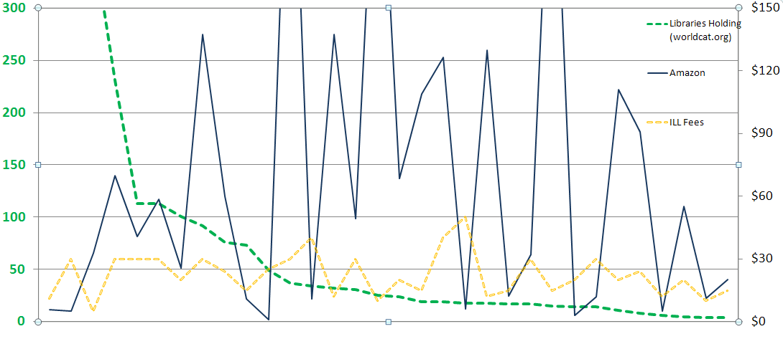
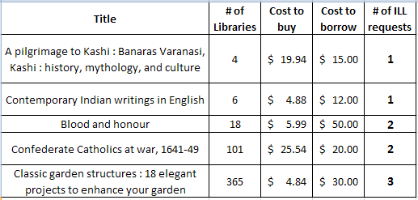
Strategies – Cost, Uniqueness, Use
Cost
# Libraries
Why Purchase on Demand / Just in Time Acquisition…
One study of Purchase on Demand books found that within 5 months
28.7% ILL Purchase on Demand books checked out again.
18% Regular Acquisition books were checked out once.
Ward, 2002
Notes:
From either an ILL borrowing or selection perspective, user initiated strategies can make a lot of sense. This graph is a look at Geneseo’s borrowing when we requested materials not held by SUNY and IDS libraries, and there were lending charges incurred for the request. The opportunity cost between borrow and buy, plus the collection diversification are key values useful for both ILL and collection development processes.
CLICK – here are some of the titles from the graphed sample. Pilgrimage & Garden examples.
CLICK – Lastly, if use is a measure of success in collection building, then Just in Time Acquisition has been shown to lead to subsequent use. How does that compare to many libraries selecting just in case that are fortunate if 50% of their new titles are ever checked out.

Slide 7
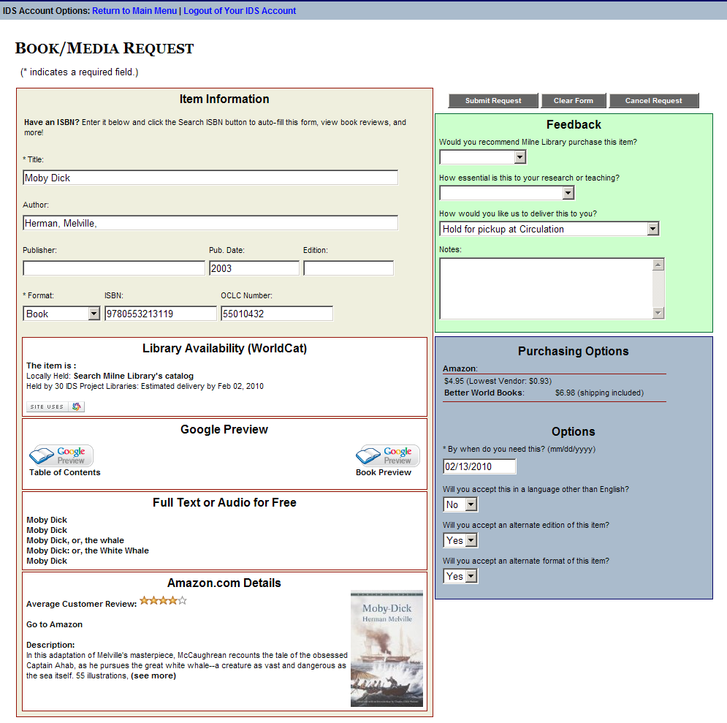
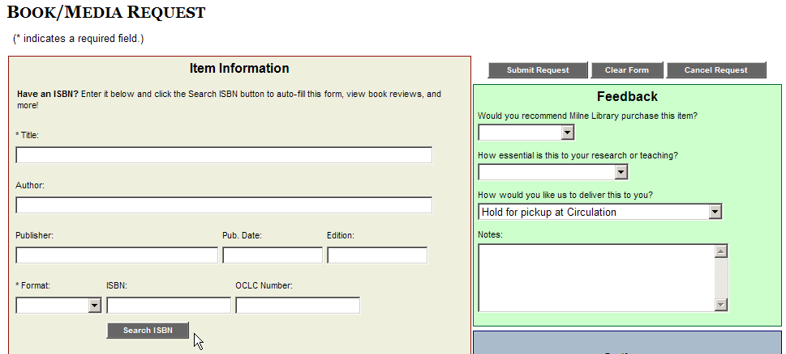
User Interface for GIST at Geneseo
Very customizable
Status specific
(Faculty, Distance Ed., Students, etc.)
Context sensitive
  Standalone w/ISBN search
  Default Loan Form
  Open URL
  Book Chapter Form
Smart components a la carte
  (Easy to turn a widget on or off, widget not displayed if no data, add widgets to Book Chapter form, etc.)
Notes:
MARK
So enough talking around GIST, let’s show you the details – this is a screenshot of the GIST ILLiad web interface, as seen from an open-url request initiated from the worldcat database.
This version has an ISBN lookup feature also, in case you are on the blank form and just want to add an ISBN and have all the information added to the form automatically.
This interface conforms to your local ILLiad web interface, so your stylesheets control the look. These forms can be customized to user status, and much more…

Slide 8
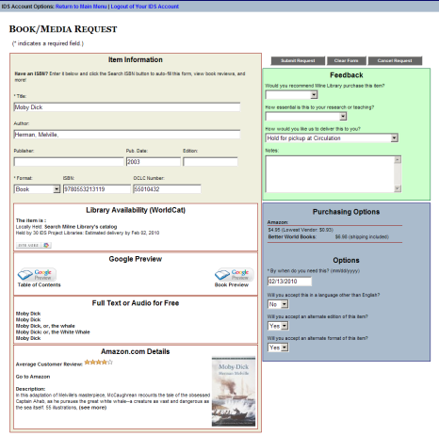
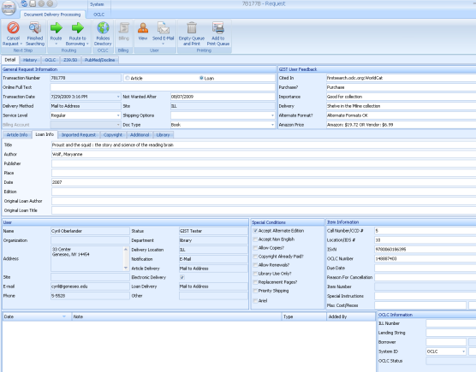
Customizable GIST Request Form
User
Interface
(Customizable display & fields)
Staff
Interface
(Customizable display & fields)
User Interface
Runs from ILLiad web server, all components can be turned off and/or hidden from user view.
Display text is configurable
Works with your style-sheets
And more…
Staff Interface
ILLiad 8+ customizable field names.
You can configure data the way you want staff to see data from user interface side, and run routing rules based on the values; i.e. available full text, purchase request suggested, holdings, etc.
And more…
Notes:
Perhaps most important is that the views the user and staff see are configurable and information dependent. So, in the basic view of the GIST Form, important to note is that the components that pulls in data from other services, i.e. Worldcat, Google, Amazon, etc., will not be shown if no data is matched during the requesting process, and in the configuration file, it is easy to turn a component on or off, or hide them within the web page, or customize the display values.
In the STAFF VIEW pre-searched data is automatically added to the staff view and turned into meaningful routing rules can be applied to route requests into specific process queues, or to make it easy to compare the cost of buying with borrowing. So let’s look @ more details…

Slide 9
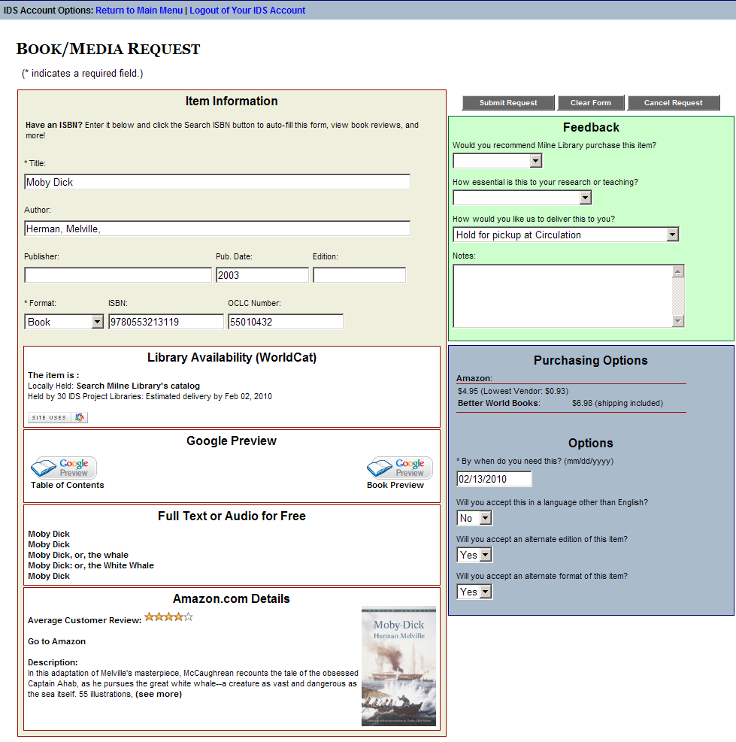
Worldcat API – Library Availability
User sees if owned locally, easy click to catalog, and sees estimated turnaround time.
ILL & Acquisitions staff see if held locally, and # holdings in 2 configurable groups (consortia, state, etc.)
ILLiad ILL
Request Form
Custom, Standalone, OpenURL, Status Specific
Google Books
User sees Table of Contents, No-Partial, & Full Text Views.
Staff see if full text in Google (GOOGL) OCLC symbol
Hathi Trust
User sees link to full-text version from Hathi Trust
ILL & Acquisitions staff see if held at Hathi Trust, and GIST 1.1 embeds the direct link to the work using a TinyURL API
Index Data
User sees if full text or audio version in Open Content Alliance, Gutenberg, Internet Archive, etc.
Staff see if full text OCA (INARC) OCLC symbol
Purchasing Options
User sees price to purchase from Amazon API with New & Lowest Price listed (used) – user may want to purchase from this link. If they do, Amazon provides our AWS account a credit for referring someone to purchase.
ILL & Acquisition Staff see the New & Lowest Price in the ILLiad requests. Better World Books, Google APIs are also currently used for pricing.
Amazon API
Enhances users request evaluation with Reviews, Ranking, Cover, and quick link to Amazon.
Price was moved into Purchasing Options window.
Notes:
There are 5 API components in the GIST interface; Worldcat API, Google Books, Index Data, Amazon, and purchasing options. By default, they are activated, however, the library can simply turn off any component they do not want to see, and how the data from each component is highly configurable for end-user, as well as, staff within the ILLiad request.
The Worldcat API – Terry Reese, Oregon State University and Kyle Bannerjee, Summit originally developed the Worldcat API for GIST, later modified and configured to work with ILLiad by Mark Sullivan. The purpose of the Worldcat API component is to bring back holdings information to the user – if held locally, it says so and the Please check your catalog is a one click into a search of your catalog using the OCLC#. The availability and estimated delivery time is set to 2 configurable groups – you might want one for your resource sharing consortia (of which turnaround times might be consistent), and the other is your state.
Google Books API enhances the user’s evaluation of the material they are requesting with additional data, such as Table of Contents or Partial Text Available, however, the user may also discover that the item they need is Full Text Available. Both ILL and Acquisitions staff see GOOGL (Google’s OCLC symbol) when a requested item is available full text, and at Geneseo, a routing rule automatically places the request in a specific queue – the staff will send the user an email using ILLiad that has the Google Book URL, and copies the electronic resources librarian to please catalog the resource. Similarly with Index Data API, a combined search of various free full text and audio sources from Open Content Alliance, Internet Archive, Gutenberg, etc. is performed and results may interest the user. The staff see INARC (Internet Archives OCLC Symbol) when a requested item is available from the Index Data sources, and again, a routing rule places that request in a specific queue for staff.
Amazons API was initially designed by Portland State University as the Price Grabber, but Mark Sullivan remade that program in .NET to be the Amazon Price Reviewer and more. This enables users more evaluation data to help their request decision making process. It also provides data for the purchasing options.
Purchasing Options is a combination of API data from Amazon, Better World Books, and Google Books. This service enables users to see price data, and click through to buy. If they buy from Amazon or Better World Books, our accounts are given credit for referring buyers. What the ILL and Acquisitions staff see in the ILLiad request is Amazon’s new and lowest cost to buy the item – which for ILL helps them determine if buying is less expensive than borrowing – there are a lot of libraries out there that charge $20 / request. For Acquisitions staff, the purchasing data eliminates the need for searching various prices. We have asked many of the book jobbers and dealers for APIs, so as we hear back from them, we plan to incorporate more, and enable easy configuration so that a library with preferred or specific vendors can activate only those purchasing APIs.
Last point we want to emphasize is that all this is very flexible, where it appears, how it looks to user and staff, so we see this as really the first template of many, as libraries adapt this, as they customize views to specific user status; faculty, student, administrator, etc.

Slide 10
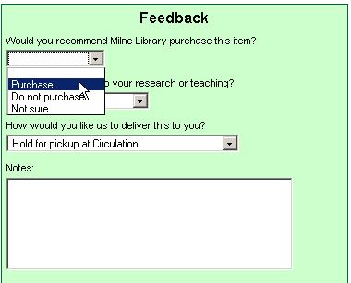
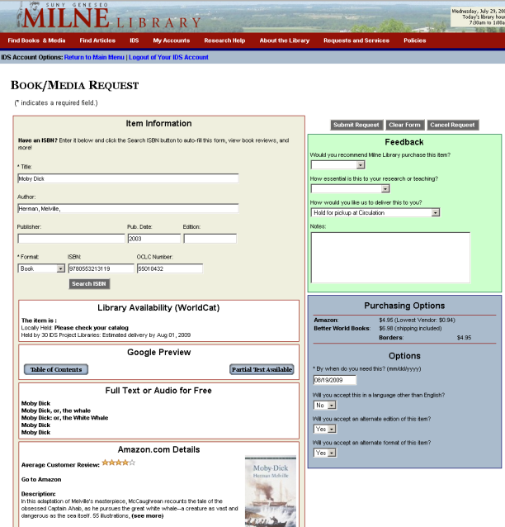
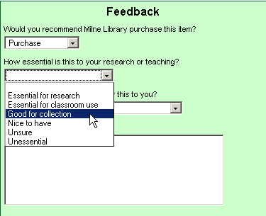
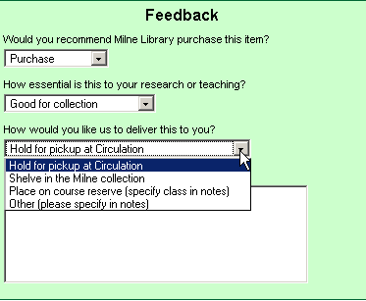
Bringing users into the conversation with customizable feedback
For Geneseo, Purchase = Acquisitions in Doc Del
Notes:
We ask our users for feedback – and you might call their responses tagging. An ILL request in ILLiad’s web pages becomes an Acquisitions request when the user selects Purchase to answer “Would you recommend Milne Library purchase this item?” As we said before, all the text, answers, and routings are customizable. The selection here is default blank, so unless the user specifies, it will be a borrowing request (unless the ILL librarian routes the ILL request to acquisitions).
Second feedback question is how essential is this to your research or teaching? Are you wondering how many people actually click on the unsure and unessential – wait, you will see?
Final feedback is finding out their delivery preference, and for the case of course reserves, they simply add the class info to the notes so when the purchased item comes in, it can be immediately placed on reserves and an email sent out from ILLiad. Again, all this is customizable by your ILLiad web and workflow experts.

Slide 11
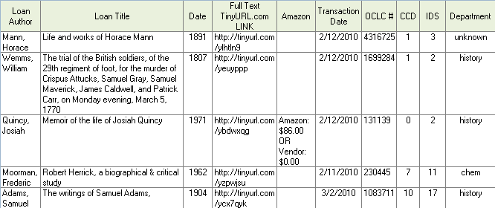
GIST 1.13 Update includes Hathi Trust & Tinyurl.com
Geneseo data from Feb. 9 – March 8, 2010
Request (delivery) interface
is now part of the discovery process

Slide 12
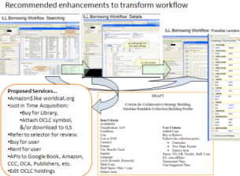

Adapt GIST to your setting
You choose and adapt the tools around what works for your setting.
Library A
Library B
Library C
Library D
Range of customization
GIST tools used to enhance ILL Purchase on Demand only.
GIST used by Librarians using status specific ILLiad web pages.
GIST also used only by Librarians to help their selection.
GIST used selectively based on ILLiad statuses.
GIST also used by Faculty, with Librarian Review.
GIST default with collection building parameters.
GIST used by all users, with some Librarian review for certain status. Collection building profiles, cooperative data, and gift management features used.
Notes:
Because GIST tools are customizable components, and libraries do love doing things there own way, we would expect to see a diversity of adaptation based on local practices and politics.
illustrate

Slide 13
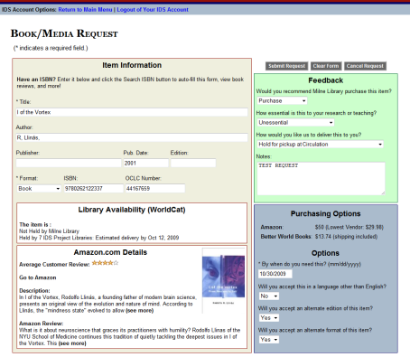
ILL & ACQ Workflow
GIST Request
Interlibrary Loan / IDS
Cancel or Unfilled
Filled
Borrow
Acquisitions
Filled
Buy
Cancel or Borrow
Requests are Transferable
Notes:
KATE
GIST requests can be either an ILL or Acquisitions request. For Geneseo, if the user recommends the library purchase the work, then the request is automatically routed into an acquisitions queue in ILLiad’s Document Delivery Module.

Slide 14
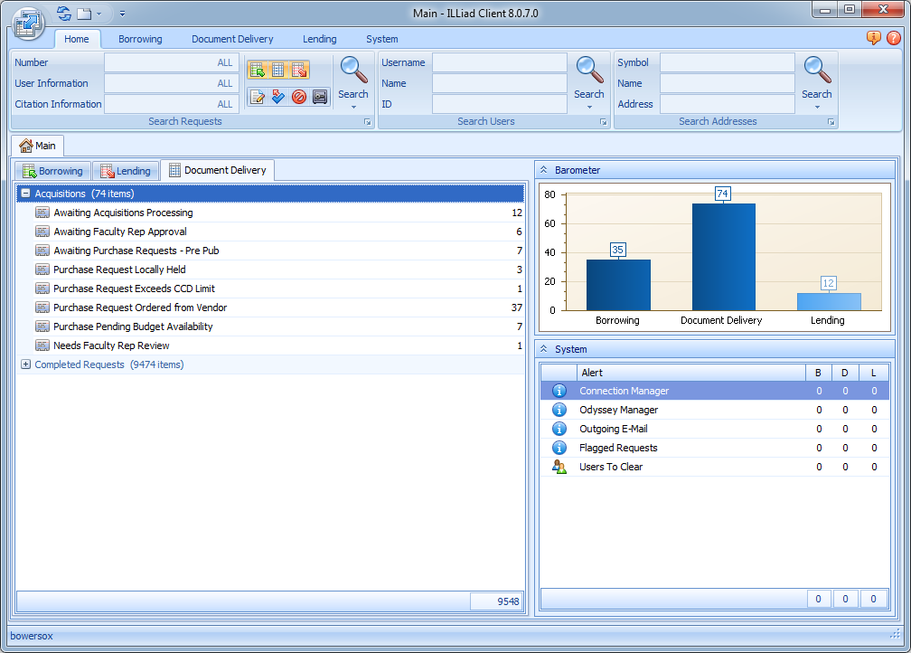
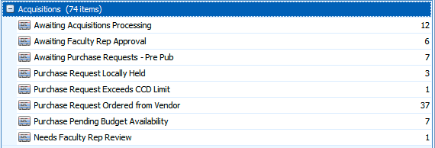
Notes:
GIST requests are placed in ILLiad’s Document Delivery menu – and processed by Acquisitions staff at Geneseo.
[ANIMATION AUTOMATICALLY IN 3 SECONDS]
You’ll notice that there are some custom queues specifically for purchase requests.
These queues are grouped within the Acquisitions category, which ILL staff can collapse to keep out of the way.
Likewise, the ILL queues have been similarly grouped, which allows Acquisitions staff to hide them.
In this example, my request went to Awaiting Acquisitions Processing because it wasn’t held locally and was not held by enough CCD libraries

Slide 15
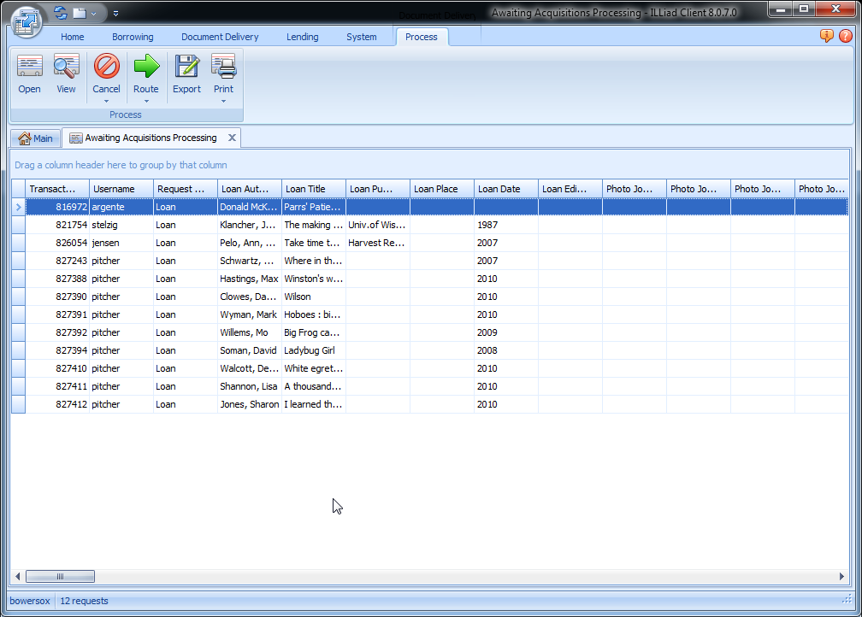
Notes:
GIST uses the WorldCat API to see how many libraries in the CCD group own the item, then sticks that number into the Call Number field.
You’ll also notice that GIST imports the number of IDS libraries that own the item into the Location field. For ILL, this is what allowed the web request form to provide a delivery estimate for the user, however, for acquisitions – it’s a way to gauge the diversity of a cooperative collection automatically.
Both fields were customized in the client to include more descriptive labels. And you can customize these fields to apply to whichever groups of libraries you’d like Summit, Oregon, NW, etc.
Also included are OCLC and ISBN numbers for quick cataloging or other searching as needed.

Slide 16
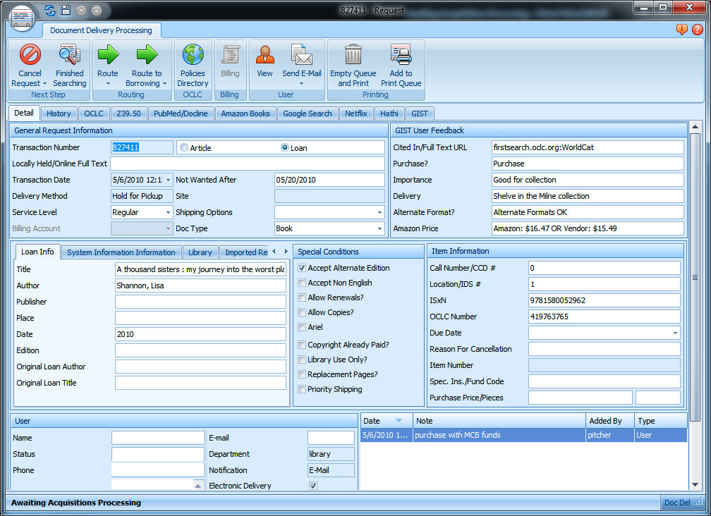
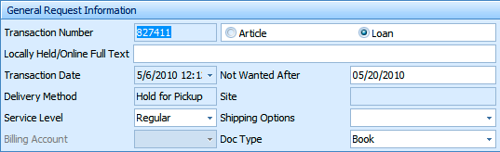
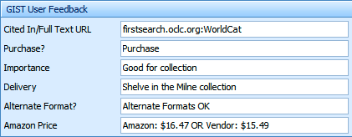
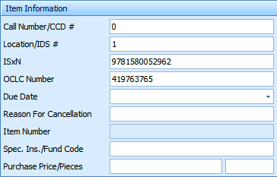
Notes:
ANIMATIONS:
Automatically in 3 seconds: item info
On click: item info disappears; general request info appears;
On click: general info disappears; user feedback appears

Slide 17
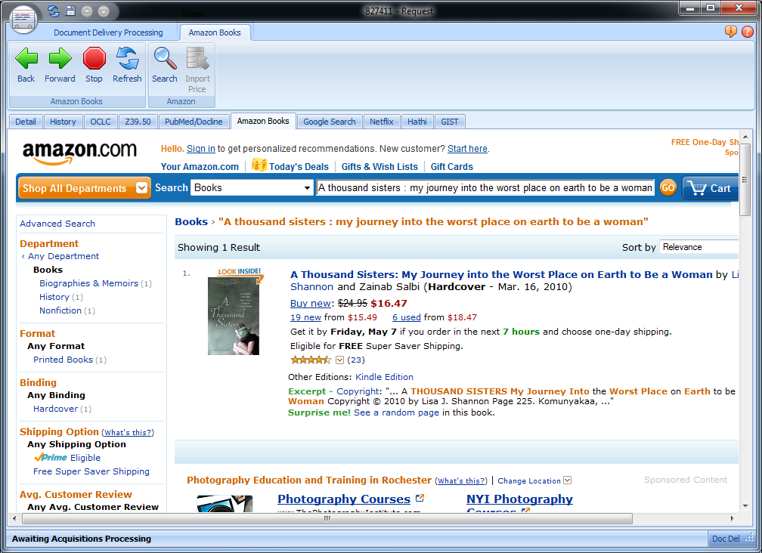
Notes:
Here’s a screenshot of the add-on in ILLiad for Amazon

Slide 18
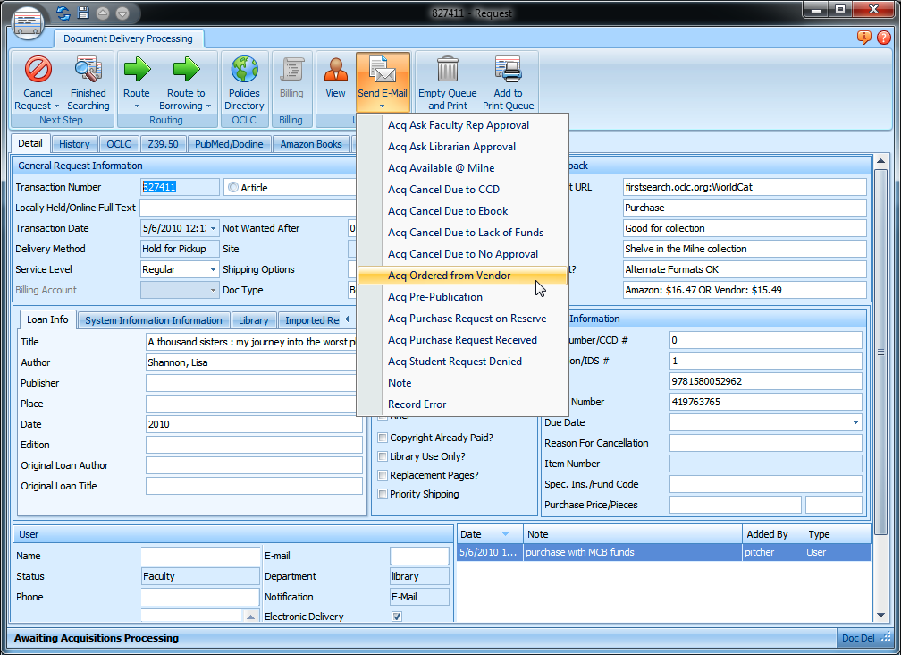

Slide 19
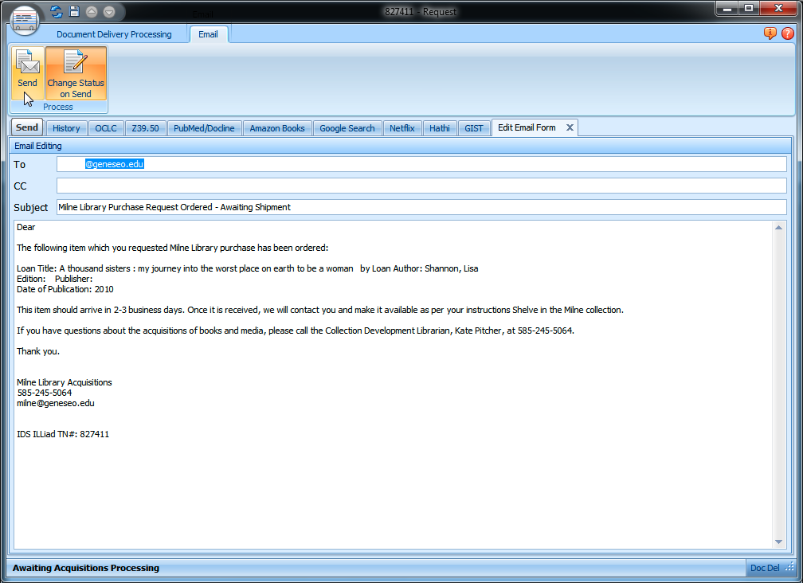
Notes:
One click of the button, and an email is sent to my patron, notifying them that the book has been ordered and we are awaiting shipment.
Email templates are completely customizable and editable, so it can say whatever you want it to say.

Slide 20
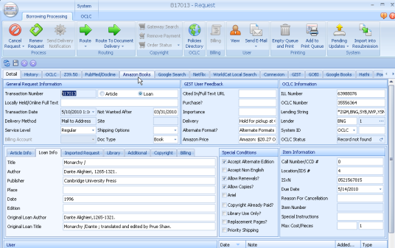
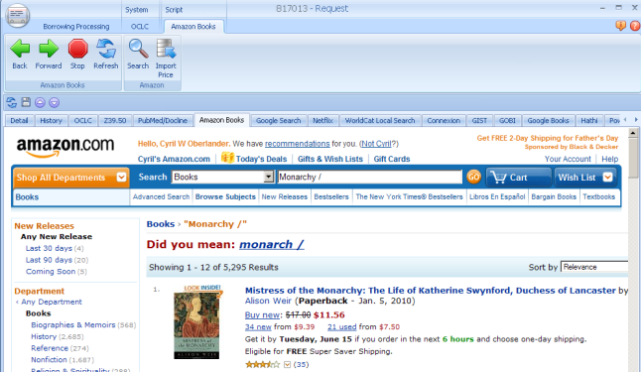
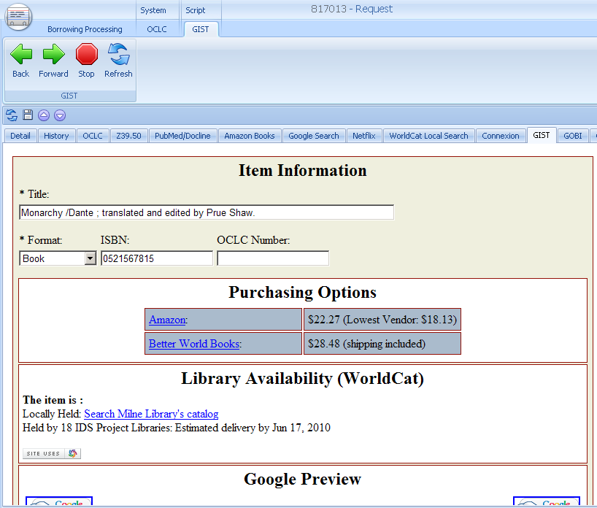
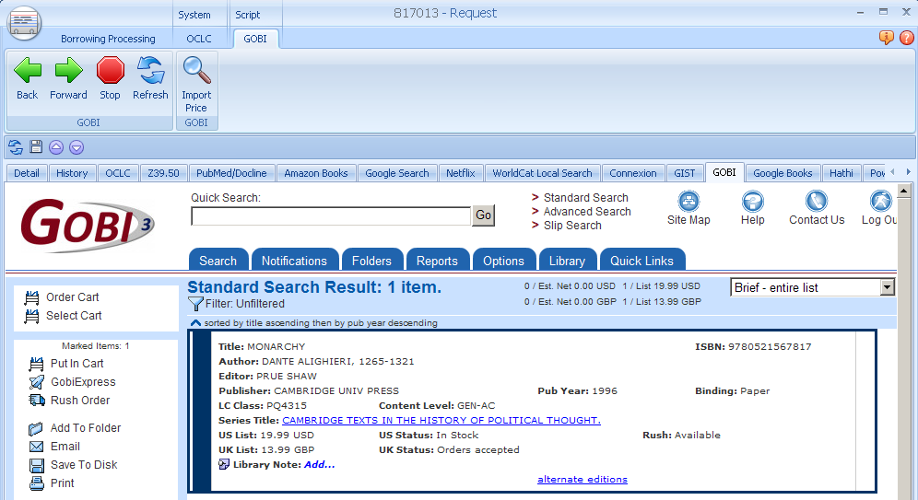
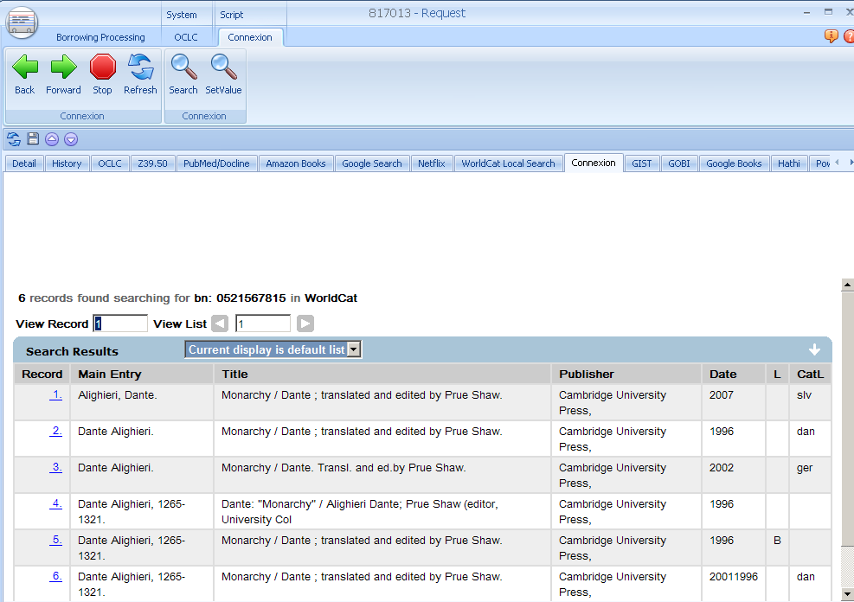
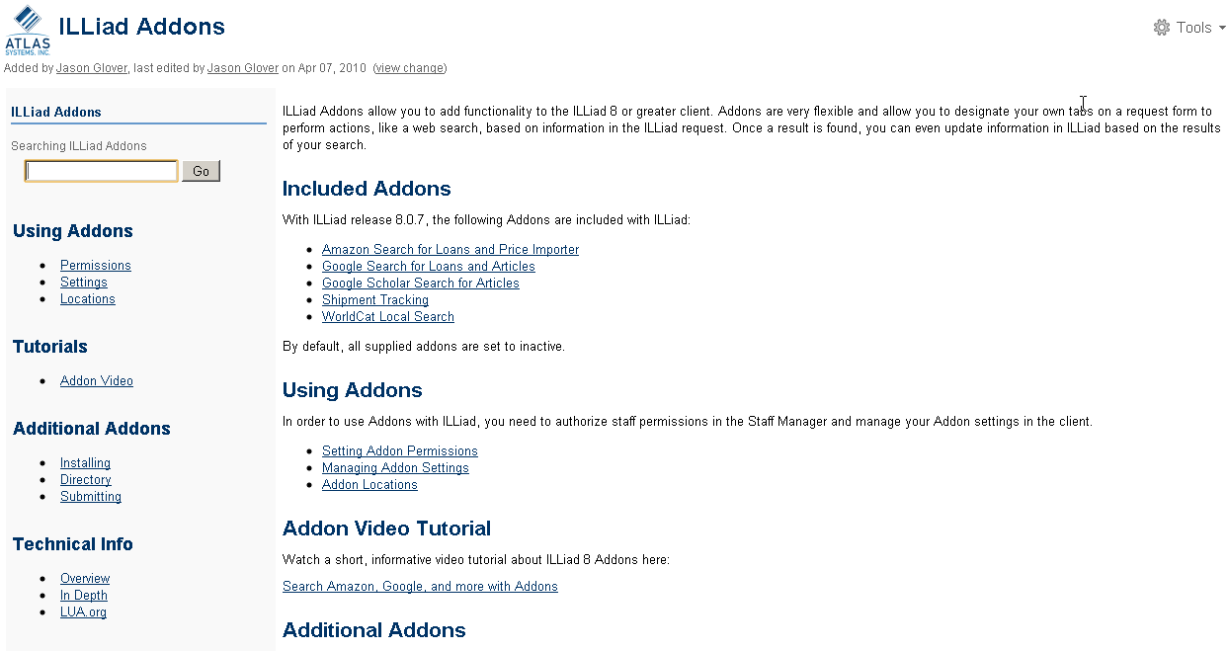
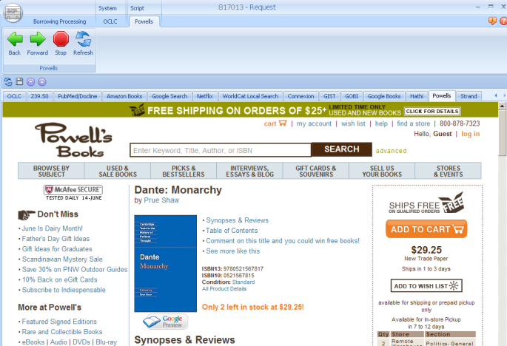
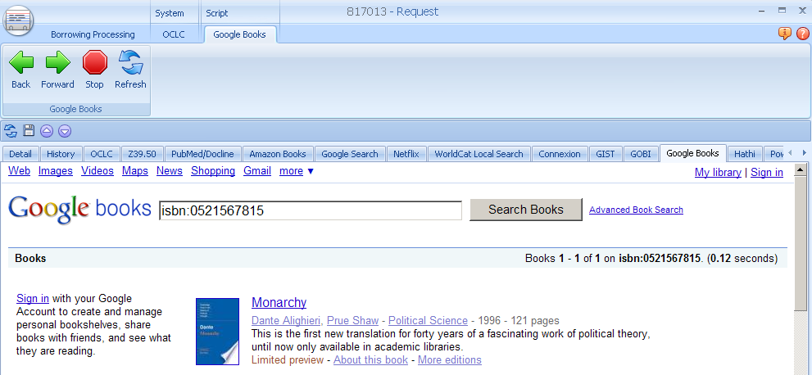
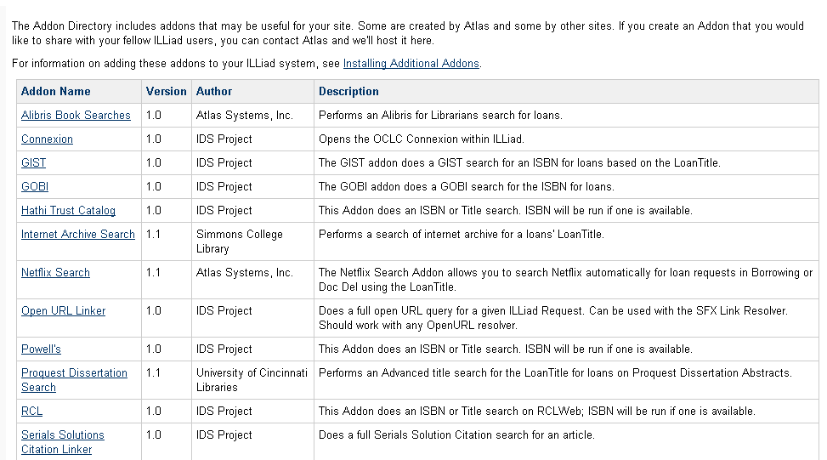
Connect any web service to your workflow:
Amazon, GIST, GOBI, OCLC Connexion, RCL Web…
A tab away
ILLiad Addons https://prometheus.atlas-sys.com/display/ILLiadAddons/Addons+Directory
Notes:
Wonderful features, a tab away! Amazon, GIST, GOBI portal, Powells, OCLC Connexion, RCL Web and more! Any suggestions for new add-ons are encouraged

Slide 21
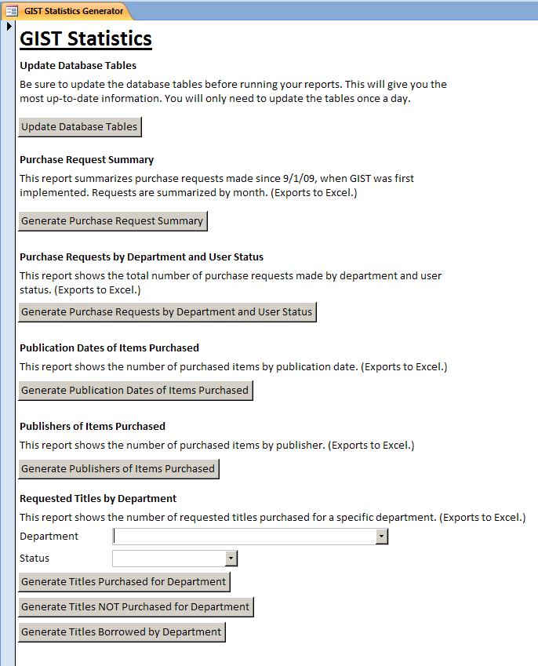
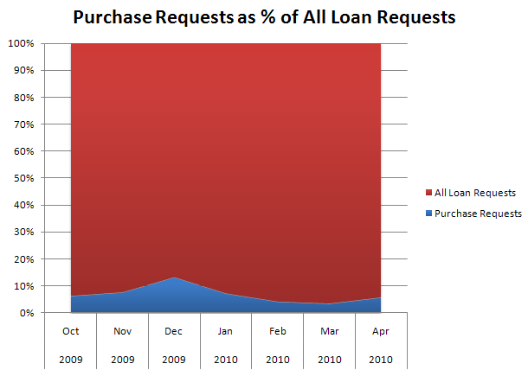
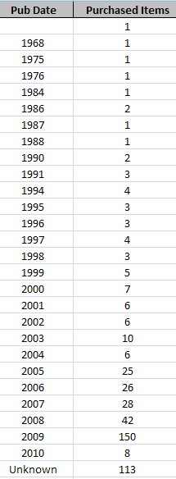
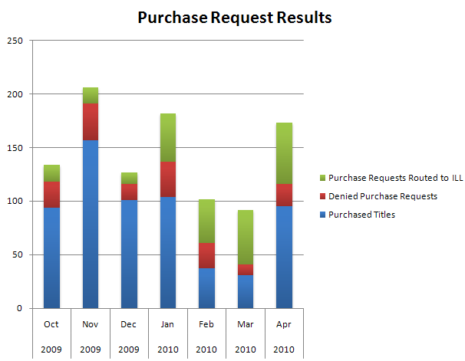
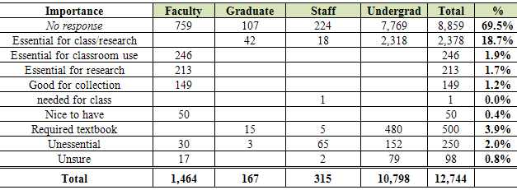
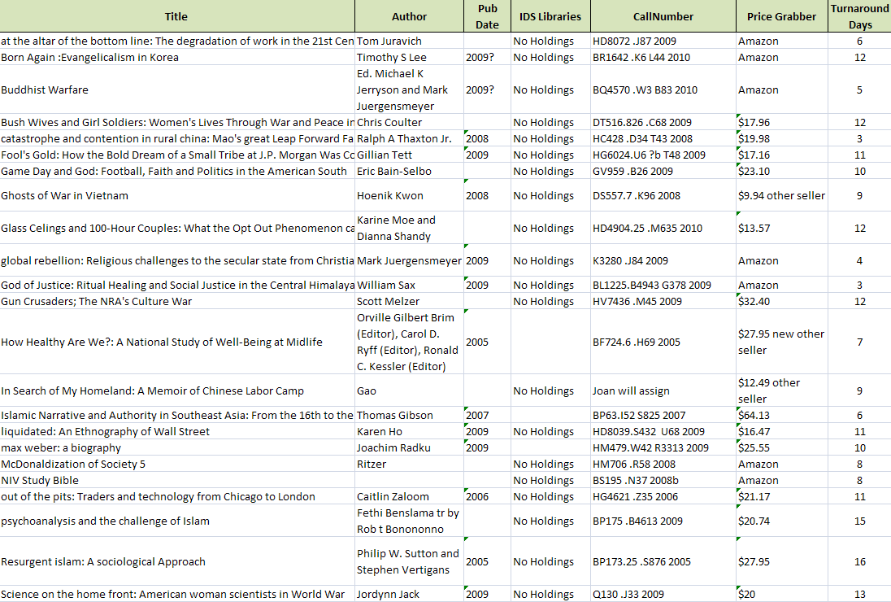
Statistical Tool
10/1/2009 – 3/1/2010 Users tagged 30% of ILL & Purchase requests…
Notes:
Cyril
The data below shows that in roughly 5 months, there were 838 purchase requests, but only 63% or 529 were purchased. Acquisitions routed purchase requests equally to ILL (16.5%) and cancelled purchase requests (16.83%) for a combined 37% of the purchase requests cancelled based on the data gathered by GIST for reasons; too widely held, locally owned, required textbook, etc. Similarly, ILL converted 28 ILL requests to purchase items based on cost to borrow and too new to borrow effectively.

Slide 22
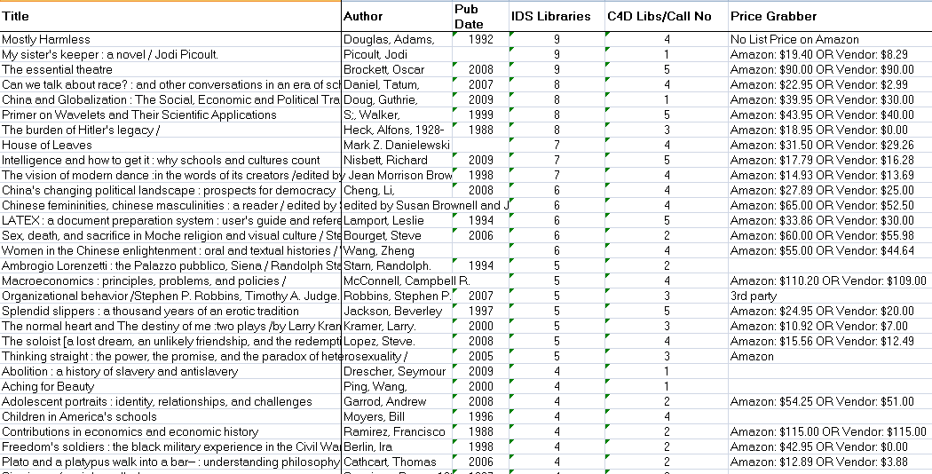
Outcome: Collection Diversity Achieved
Recommended titles not purchased because too widely held
# Holdings in IDS Libraries
Quick delivery libraries

Slide 23
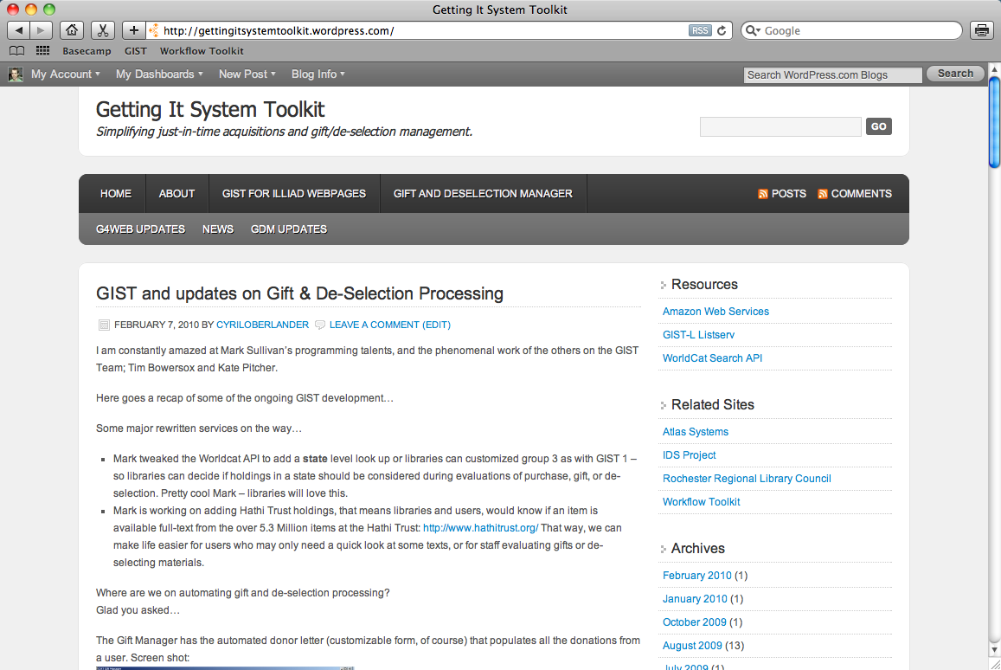
Documentation & downloads @ http://gist.idsproject.org
Notes:
MARK

Slide 24
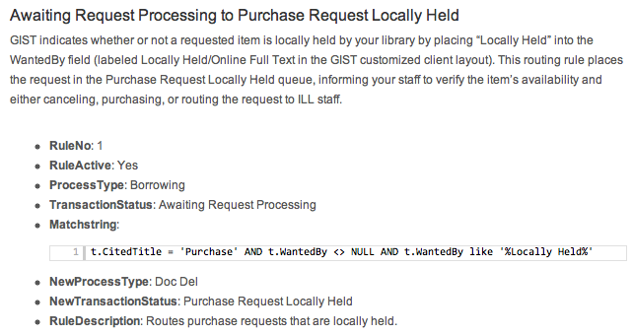
GIST Documentation
HTML, scripts, custom layouts, & email templates
Complete installation & implementation guide
Sample routing rules, email routing, & custom queues
How to get started using a test implementation
Sample routing rule with copy & paste MatchString

Slide 25
GIST Requirements
ILLiad 8 client
Staff manager access
Customization Manager access
Access to your ILLiad web server (written on .net framework so GIST will work for OCLC hosted sites)
Basic knowledge of HTML and CSS
Communication & coordination between your acquisitions, ILL, administration & web person

Slide 26
We guide you through…
Creating the necessary routing rules & custom queues
Creating email routing for your workflow
Managing access to the client for acquisitions staff
Customizing your ILLiad web pages
Repurposing ILLiad’s request fields
Customizing the client interface
All found on the GIST Workflow Toolkit
http://gist.idsproject.org
Now for the real tough part…

Slide 27
GIST Acquisitions manager
In Development – to be released August 2011
GIST Goals:
Optimize workflow by leveraging systems to do more work while reducing the time staff spends to make informed decisions and process materials.
GIST Acquisitions Manager
Further develop GIST for Web to incorporate budget information.
Develop acquisitions features, such as budget, fund, and invoice management features in an Acquisitions Manager component.

Slide 28



GIST Acquisitions Manager
Hold for Pickup
Mail to Address
Place on Reserve
Shelve it
Other?
Purchasing
Price Check
GIST Addon: Amazon, Alibris, BWB, GOBI, You select your vendor
Ordering Process
GIST Addon: Fund Manager Interface
Check current FUNDS (associated with username, department, and general purpose), import current FUNDS.
Apply FUNDS in real time.
Purchasing Process
Amazon Addon: (one example)
Import Order Total, Order Number, Estimated shipping date, Delivery URL
Print Procurement Form – institution specific (addon &/or report)
Holdings Process
OCLC Addon: Open OCLC Connexion – search, import LC#.
ILS Addon: Create Hold? (long-term TAG project)
Funds
Configure visibility as appropriate: On/Off,
Username & Funds,
Dept – General Fund,
Description: Radio button w/name & totals
Receiving Process
Depending on if library adds holdings at point of order…
Holdings Process
OCLC Addon: Open OCLC Connexion – search, import LC#.
ILS Addon: Create Hold?
Review Process
Email Routing
Send to Reviewer:
Link to GIST-Like Form to see CURRENT Budgets (FUNDS) and trigger Approve / Do Not Approve
Email reply triggers action via EmailImport
Notes:
Cyril

Slide 29
GIST User Interface Scenario:
Fund selection & insufficient funds
Purchasing transparency (on/off?)
Purchasing Options (Status & username specific) with Acquisitions Manager data: only faculty may see their department and if applicable username specific budgets; library staff in GIST addon see all budgets and can apply changes for import – see next slide.
Cost:
Amazon $4.95 (Lowest Vendor: $0.09)
Better World Books $6.49 (shipping included)
Budget: Select budget applied to this recommendation:
History General $553 remaining
Urban History Project Grant $58 remaining
Conditional business rule; if assigned budgets are depleted (or end of year) – system routing applies or librarian review web interface.
Insufficient funds - Recommend for next year or if additional funding is available.
Fiscal year ended - Recommend for next year’s budget.
Donate funds?

Slide 30






Basic Scenario of Purchasing Amazon order
User updated on purchasing
OCLC Addon: import record, attach symbol, and add call number after cataloging in OCLC. Import record in ILS?
Use GIST Addon to check funding; user designated and related funding options and budgets
Purchase from Amazon, import shipping fee (3rd party), Price, order #, YBP if purchased from GOBI, (shipping URL/Tracking & expected date nice to have).
Review Process
Email Routing or Web Interface
Send to Reviewer:
Link to GIST-Like Form to see CURRENT Budgets (FUNDS) and trigger Approve / Do Not Approve
Email reply triggers action via EmailImport
Customizable Print Forms
Print procurement or other forms using MS Access or Addon.

Slide 31
GIST Reviewer Web Interface Scenario:
(alternative to current use of email routing)
Email link to open OpenURL like reviewer form to Approve or Disapprove
Purchasing Options (Status & username specific) with Acquisitions Manager data: only faculty may see their department and if applicable username specific budgets; library staff in GIST addon see all budgets and can apply changes for import – see next slide.
Cost:
Amazon $4.95 (Lowest Vendor: $0.09)
Better World Books $6.49 (shipping included)
Budget: User selected budget applied to this recommendation:
User selected budget
History General $553 remaining
User associated budgets
Urban History Project Grant $58 remaining
Drop down list of other budgets appropriate to reviewer.
Conditional business rule; if assigned budgets are depleted (or end of year)
Insufficient funds - Recommend for next year or if additional funding is available.
Fiscal year ended - Recommend for next year’s budget
Recommended by:
First Last name
Approve
Approve & Select Fund
Deny & Convert to ILL

Slide 32
We are a Divided house & Workflow
Acquisitions Librarian, Assoc. Director for Technical Services
ALA ALCTS
Chareston Conference
AcqNet
Library Acquisitions, Practice & Theory (later title: Library Collections, Acquisitions, & Technical Services)
Head of Interlibrary Loan
Access Services Librarian
Interlibrary Loan or Resource Sharing Librarian
ALA RUSA STARS & IFLA ILDS
Journal of Interlibrary Loan, Document Delivery & E-Reserve
Journal of Interlending & Document Supply
Journal of Access Services
Acquisition
ILL
Systems
Collection
Development
or
Subject Librarian
Systems Librarian
ALA LITA
Computers & Libraries
JASIST
Information Today
Library Journal
Science, Engineering, History, etc.
Librarian
ALA many separate divisions
American Libraries
Against the Grain
“for monographs, purchase may be a reasonable substitute for interlibrary loan.”
Holley, Robert, Kalyani Ankem, “The effect of the Internet on the out-of-print book market: Implications for libraries,” Library Collections, Acquisitions, & Technical Services, vol. 29, 2005, p. 118-139.
Notes:
Our house and family aren’t exactly on the same page, CLICK let’s look at the most obvious trend toward convergence with selection, just in time acquisitions, and purchase on demand…
Each stakeholder has very different views (ALA divisions, journal titles, etc.) of the elephant in the room, and each library type has a rather isolated view of the piece of the elephant they have. This is similar to Reference and Circulation.
The elephant is the relationship between collection, community, our identities and workflow…

Slide 33
Models and Strategies
How much Just-in-Case (Librarian or Vendor) selection makes sense?
10% - 30% - 50% - 70% - 90% of monograph budget
How much Just-in-Time (User initiated) selection with data strategies i.e. cost to borrow, # holdings, etc. makes sense?
10% - 30% - 50% - 70% - 90% of monograph budget
Notes:
Do they know how much of their monograph budget is spent on this?

Slide 34



GIST Gift & Deselection manager
Notes:
You can even use the deselection manager to evaluate journals held in a consortia or state – we ran it for a group of Ohio libraries looking at JSTOR titles.

Slide 35
What is local collection today?
With 13 % of titles in storage available FULL-TEXT through Hathi Trust digital repository, similarly as the number of full-text increases with Google Books and other projects…
What is the impact on our print holdings and records for print holdings?
Questions
Do we deselect and convert our print record to an electronic holdings record?
Do we not catalog because GIST for web detects Hathi Trust & Google Books full-text holdings?
Do we catalog materials we don’t hold if GIST for web detects full-text holdings?
Notes:
Time it takes to convert records – is it worth retaining holdings numbers in statistics?
Hathi trust holdings over 10% Google Books API also available
31,436 total
2 titles = 0 holdings in IDS project libraries
Using data from GIST, only 2596 titles were kept in the collection; the remainder are being weeded
Selecting donations

Slide 36



Conspectus
Notes:
http://gettingitsystemtoolkit.wordpress.com/gift-deselection-manager/customizing-the-conspectus/
The OCLC Conspectus is a subject hierarchy consisting of divisions, categories, and subjects. The conspectus provides a framework to describe library collections, and is mapped to Dewey Decimal, Library of Congress and National Library of Medicine classification schemes. The conspectus is structured in hierarchical order, from broad divisions to very specific subjects and each level is increasingly more detailed.
Why customize the conspectus?
Setting up the conspectus in GDM allows for libraries to customize and automate the gift management workflow. Libraries may determine which areas of the conspectus they might want to collect and other subject areas that are out of scope. Making these decisions ahead of time and customizing GDM will automate much of the evaluation workflow. Libraries can decide what divisions and categories they wish to grow and then set up collecting levels and uniqueness factors to automate those decisions. Libraries can also set up strict guidelines for keeping or not keeping publications dependent on date limits. For example, if you wanted to collect comprehensively in Geography and Earth Sciences – Meterology, but only within the last 5 years of publication, you would want to set your collecting level to “5”, a uniqueness factor of “1″ (to avoid duplication in your collection), and set your “If Newer than” settings to 5 and click in the box for Strict.
Weighting
A number of factors make up the Weight score which effectively determines whether or not GDM indicates a “Keep” or “Do Not Keep” recommendation. Holdings, publication dates, uniqueness and collecting level are factors that affect the final weighting of an item. The higher the weight score, the recommendation will be to Keep an item, due to these factors. A lower weight indicates an item of less desirability than the higher weighted item.
Weighting Logic
The first step of the weighting logic is to determine if either of the strict date restrictions apply. If NewerThanStrict is checked and the item is older than the limit or if OlderThanStrict is checked and the item is older than the limit, then the preliminary weight (pWeight) is automatically set to 500. Otherwise, the pWeight is based on the combination of the age of the item in relation to the NewerThan and OlderThan settings and the number of libraries in Group2 and Group3 that own the item.
Once pWeight has been established, the formula to modify it has to be determined. This formula is based upon whether Gift Manager or Deselection Manager is active, and, if the Gift Manager is active, then whether the item is held locally. Based on those results, pWeight is modified differently by the Unique and Collection Building numbers.
After the final pWeight is determined, a check is made to determine if pWeight is less than 1. If it is, then it is set to 1. The final WeightingScore is determined by dividing 10000 by pWeight.

Slide 37
GIST Project Roadmap
GIST 2010-2011
GIST Acquisitions Manager
Develop efficient budget, fund, and expenditure system that is streamlined and integrates into ILLiad and GIST.
Continue to innovate staff and end-user interfaces to budgets, purchasing, and review workflow that incorporates web and complex addon developments.
GIST for Web
Document diverse strategies and workflow using GIST
Enhance GIST use of ILLiad fields and tables, and enhance use of ILLiad web pages.
GIST GIFT and Deselection Manager (GDM)
Post-release modifications as libraries begin using GDM.
Add statistics component and enhance batch processing.
Other?

Slide 38
GIST Project Roadmap
GIST 2011-2012
GIST Acquisitions Manager enhanced for pay-per-view for articles registry.
GIST for Web incorporate free and pay-per-view article resources, add format and edition FRBR recommender services, and enhance user experience with non-print resources.
GIST GDM add Circulation and TPAM2 data.
Other?

Slide 39
Acquisitions + Interlibrary Loan
What makes sense?
Buy and borrow strategy convergence – yes / no
Workflow co-exist in ILLiad – yes / no
ILL and Acquisitions units merge – yes / no
Just what you need collections? – yes / no
Other ideas?
Borrow
Buy
Deliver
User Request
+
Library Service Strategy

Slide 40
Thank you
Cyril Oberlander – cyril@geneseo.edu
Mark Sullivan – sullivm@geneseo.edu
Kate Pitcher – pitcher@geneseo.edu
Tim Bowersox – bowersox@geneseo.edu

